Slide 1


HR ANALYTICS PROJECT
DATA-DRIVEN WORKFORCE MANAGEMENT AND EMPLOYEE INSIGHTS
T EAM 2
BASSEM MOSTAFA
SARA NARDEN

Slide 2

INTRODUCTION TO HR ANALYTICS
Why HR Analytics Matters
DRIVING STRATEGIC WORKFORCE DECISIONS
HR Analytics empowers organizations to transform raw employee data into actionable insights. By understanding workforce trends, companies can optimize hiring processes, enhance employee performance, and proactively manage attrition to build a more productive and engaged workforce.
KEY BENEFITS
• Improved Recruitment
• Enhanced Performance
• Reduced Attrition
• Increased Productivity
• Better Retention

Slide 3

BUSINESS PROBLEM
PROBLEM STATEMENT
Addressing critical gaps in workforce management to enable informed, data-driven decision making.
CORE ISSUES
• High Employee Turnover: Impacts productivity and increases costs
• Performance Tracking: Difficulty measuring effectiveness
• Recruitment Inefficiencies: Slow hiring processes
• Lack of Insights: Absence of centralized HR data
Analytics Evolution
Descriptive → What happened?
Diagnostic → Why did it happen?
Predictive → What will happen?
Prescriptive → What should be done?

Slide 4
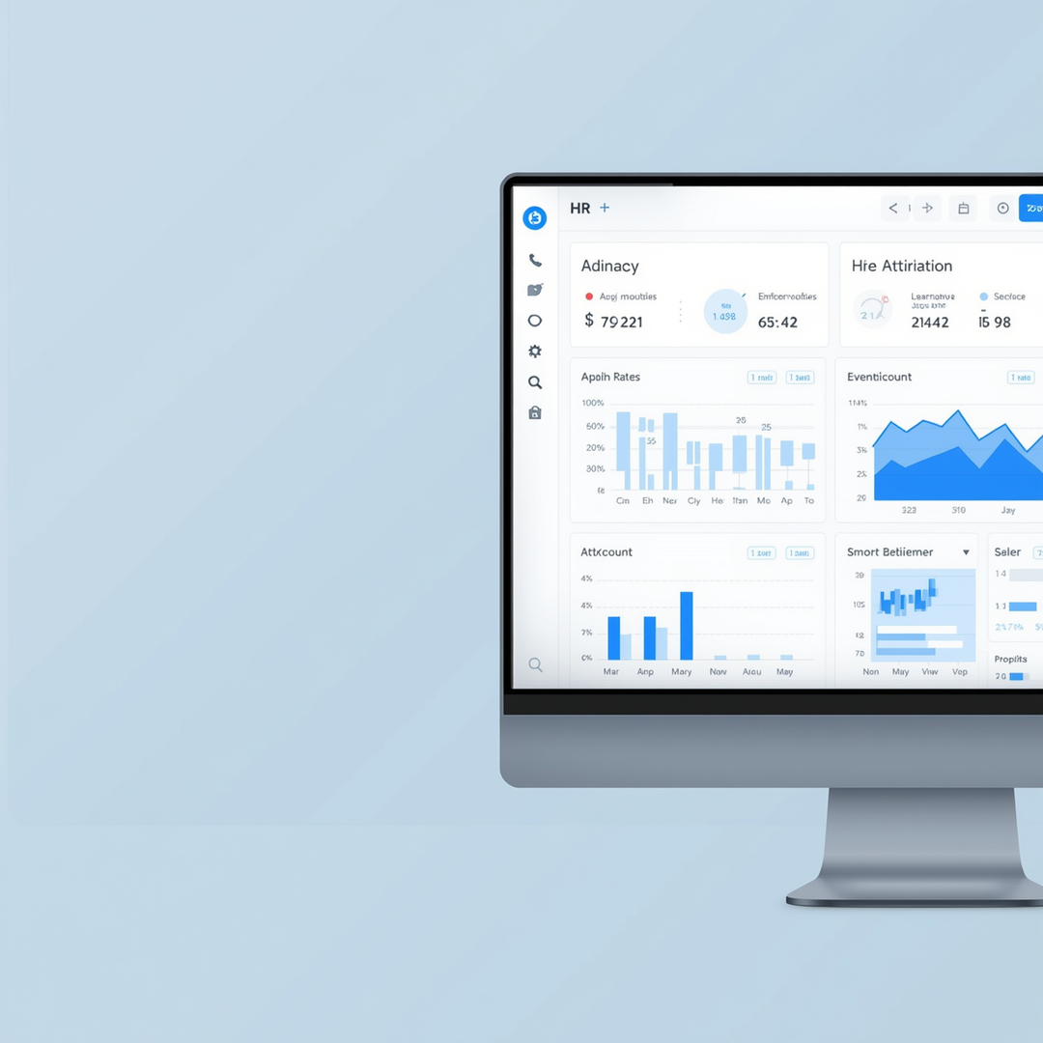
PROJECT OBJECTIVES
KEY OBJECTIVES
• Analyze employeebehavior to identifyattrition drivers
• Detect high-riskemployees early
• Support HR decision-making with data
• Monitor workforce health

Slide 5

USE CASES
Centralized data
Structured storage
Automated pipelines
DATA SOURCES
DATA INTEGRITY
All sources are cleaned and standardized for analysis.
Data Categories
• Excel Files: Primary data repository
•• Hiring & Attrition: Recruitment and historical exit data

Slide 6
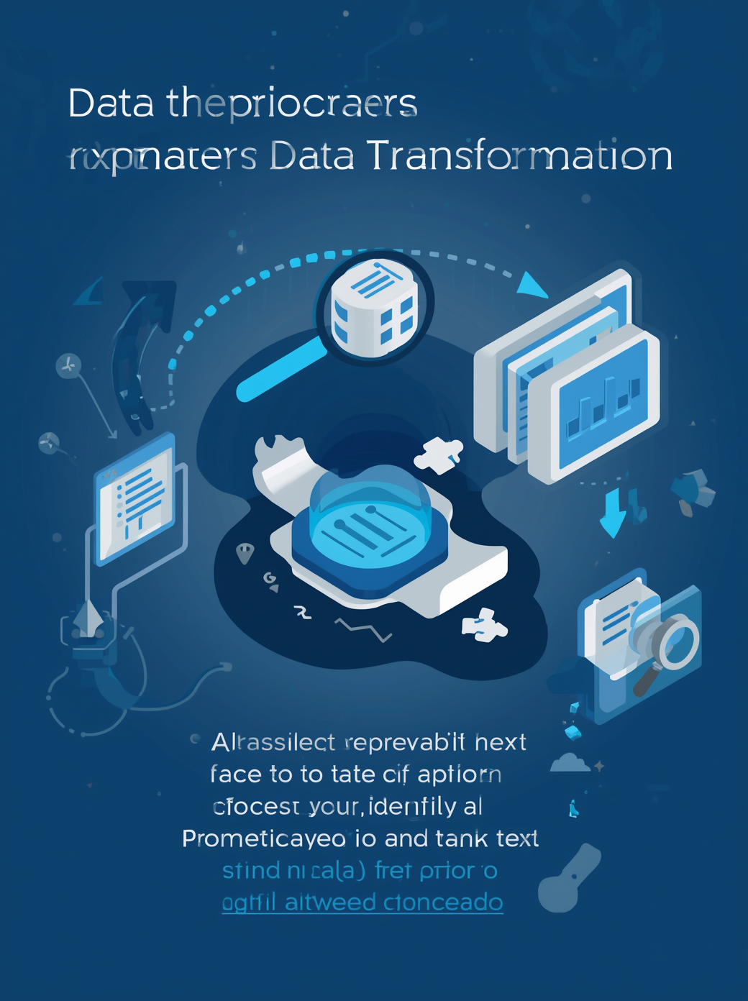
DATA CLEANING PROCESS
Remove Duplicates
Eliminate duplicate records to ensure data accuracy
DATA CLEANING METHODOLOGY
Handle Missing Values
Use imputation or exclusion methods for completeness
Ensure consistent formats and verify data reliability
Standardize & Validate

Slide 7

TRANSFORMING RAW HR DATA INTO A STRUCTURED, EFFICIENT STAR SCHEMA FOR OPTIMIZED QUERYING AND REPORTING.
DATA MODEL
STAR SCHEMA DESIGN
Data Model
Fact Tables: Store measurable KPIs (Recruitment, Performance, Pulse)
Dimension Tables: Descriptive info for filtering (Employee, Calendar)
Benefits: Faster analysis & improved data relationships

Slide 8
KEY PERFORMANCE INDICATORS
General & Executive KPIs
Total Headcount: 10K Employees
Attrition Rate: 23.87%
Average Tenure: 22.24 Years
KPI Achievement: 73.98%
Performance & Satisfaction KPIs
KPI Achievement: 73.98% (Target: 74.56% | Gap: -0.78%)
Skill Acquisition: 66.10% (Target: 0.66 | Gap: +0.42%)
Quality Of Work: 69.81% (Target: 70.28% | Gap: -0.67%)
Pulse Score (Satisfaction): 70.55 (Target: 71.49 | Gap: -1.32%)
Compensation & Cost KPIs
Total Salary: $1.25bn
Comp Vs Market: +8.76% (Above market average)
Total Acquisition Cost: $1.84bn
Average Cost Per Hire: $73.67K
Retention Risk KPIs
High Risk & Below Market Employees: 346
High Potential & High Risk Employees: 8 (Critical Talent)
Average Tenure Of Leavers: 22.32 Years

Slide 9

INSIGHTS FROM DATA
Executive & Performance Summary
The High-Level View: Managing a workforce of 10K employees with a stable overall average tenure of 22.2 years.
Performance Gap: General KPI achievement hit 73.98%, narrowly missing the 74.56% target.
Skill vs. Engagement: While Skill Acquisition (+0.42%) exceeded targets, Quality of Work (-0.67%) and employee Pulse Scores (-1.32%) both fell short, highlighting a dip in morale.

Slide 10
INSIGHTS FROM DATA
The Retention & Attrition Challenge
Historical Surge: Attrition has steadily climbed from ~5% in 2018 to a peak of 23.87% in 2024.
Why People Leave: The primary driver is Voluntary: Better Offer, closely followed by Low Engagement.
Demographic Flight: The 51+ age band exhibits the highest turnover at 26.20%, posing a critical risk of senior knowledge loss.

Slide 11
INSIGHTS FROM DATA
Compensation & Cost Visuals
The Cost of Pay Disparity: Attrition skyrockets to 32.71% for employees paid Below Market, compared to 19.76% for those paid above market.
Department Hotspot: Engineering consumes the largest salary share ($0.34bn) but houses the highest risk volume, with 84 underpaid, high-risk employees.
High Recruitment Costs: The organization spends an average of $73.67K per hire, heavily driven by premium external sourcing channels like LinkedIn and Job Boards.

Slide 12
INSIGHTS FROM DATA
Critical Talent Risk (Immediate Action Required)
The Core Target: 346 employees are currently flagged as High Risk & Below Market.
The Urgent 8: 8 High-Potential, High-Risk individuals are on the verge of leaving.
Departmental Breakdown of Critical IDs:
Engineering: EMP_019330, EMP_020885
Finance: EMP_018219, EMP_024696
Product: EMP_009713, EMP_020039
HR / Operations: EMP_022164 / EMP_021106

Slide 13

TOOLS & TECHNOLOGIES
Teck Stack
Excel
Power BI
DAX

Slide 14

HR RECOMMENDATIONS
1. Immediate Retention Interventions (Critical Talent)
Save the "Urgent 8": Lock in the 8 High-Potential / High-Risk employees immediately. HR should bypass standard annual review cycles to conduct stay-interviews and offer immediate retention bonuses or fast-track promotions.
Targeted Salary Corrections: Prioritize a compensation market-alignment initiative for the 346 employees flagged as "High Risk & Below Market." Focus first on Engineering (84 staff) and Sales (55 staff), where the volume of underpaid, flight-risk talent is densest.

Slide 15
HR RECOMMENDATIONS
2. Structural Compensation & Recruitment Strategy
Shift Budget from Acquisition to Retention: The organization faces a staggering average cost per hire of $73.67K, fueled by heavy spending on LinkedIn and external Job Boards.
Optimize Sourcing Channels: Scale up lower-cost, higher-retention hiring pipelines. Expand Employee Referral Programs and Internal Transfers, which currently account for the smallest portions of the acquisition cost pie.

Slide 16
HR RECOMMENDATIONS
Engagement & Workforce Morale
Address the "Low Engagement" Exit Trigger: Because "Low Engagement" is verified as the second largest driver of voluntary resignations—and backed by a failing Pulse Score (-1.32% off target)—the company must overhaul its workplace culture.
Actionable Steps: Implement quarterly pulse surveys to pinpoint exact friction points, introduce flexible work arrangements where applicable, and launch structured manager-training frameworks to improve daily team environments.

Slide 17
HR RECOMMENDATIONS
Workforce Planning & Knowledge Management
Demographic Succession Planning: With the 51+ age band leading attrition at 26.20%, the company is actively losing its most senior institutional knowledge.
Actionable Steps: Establish a formal Phased Knowledge-Transfer Program. Pair exiting senior staff or employees nearing retirement with high-potential individuals in the 22–30 and 31–40 age bands to secure critical operational workflows before the talent departs.

Slide 18

THANK YOU

Slide 19

QUESTIONS & ANSWERS
WE WELCOME YOUR QUESTIONS AND FEEDBACK.

